Slide 1
Development of knowledge-based societies

Slide 2
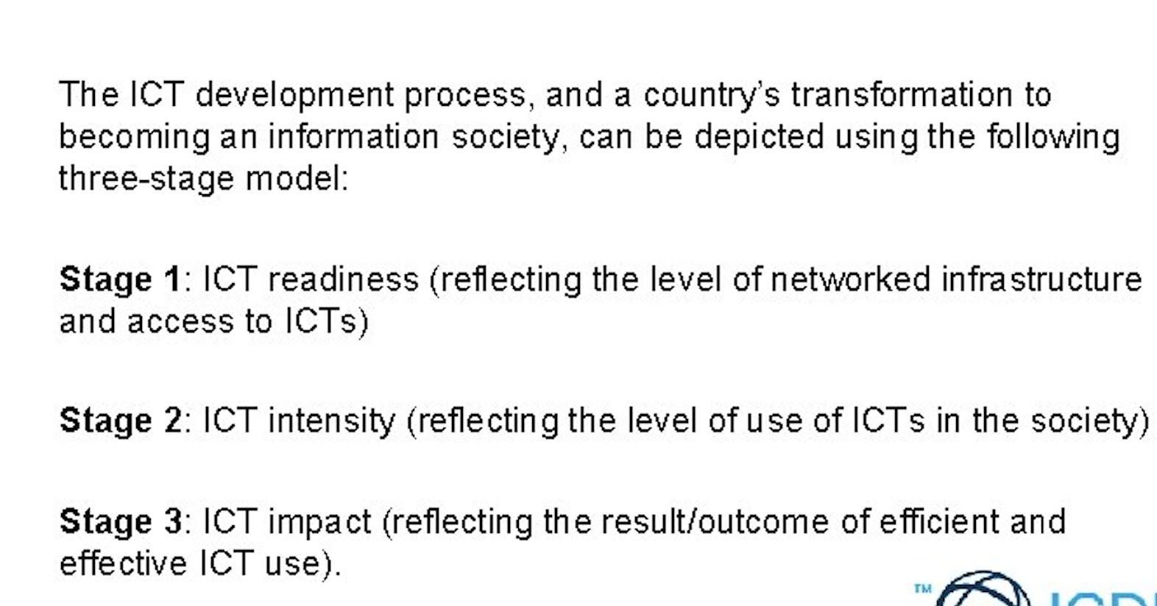
ICTs and development,

Slide 3
Delivery of public information and services through digital
e-government
e-Business

Slide 4
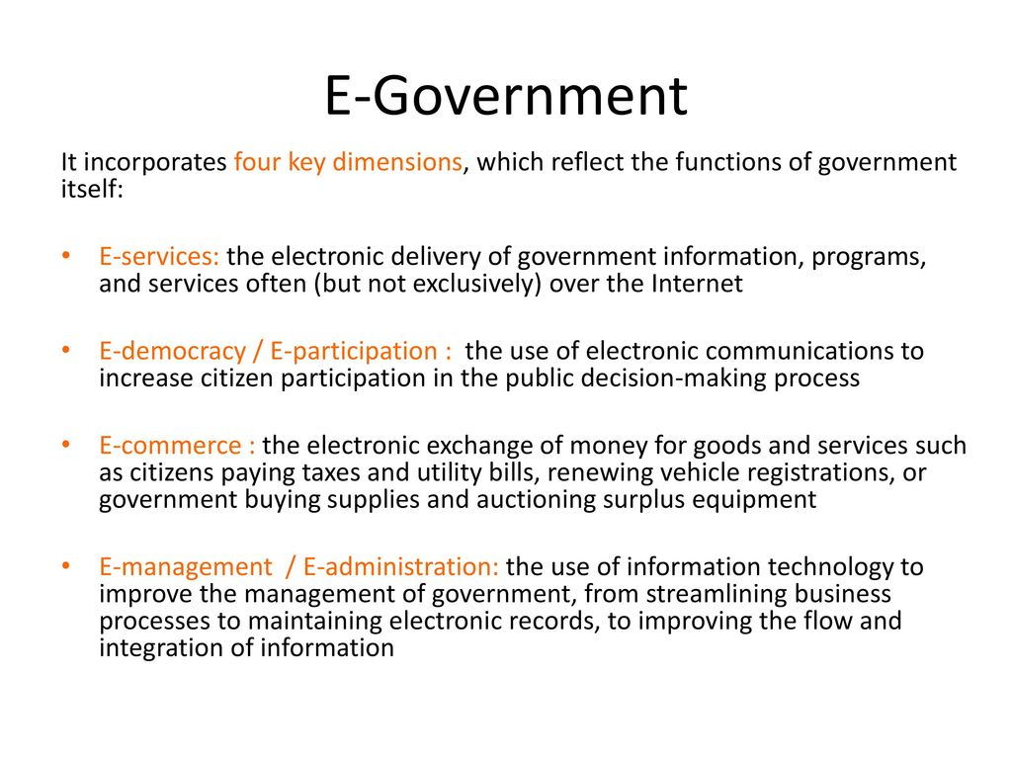

Slide 5
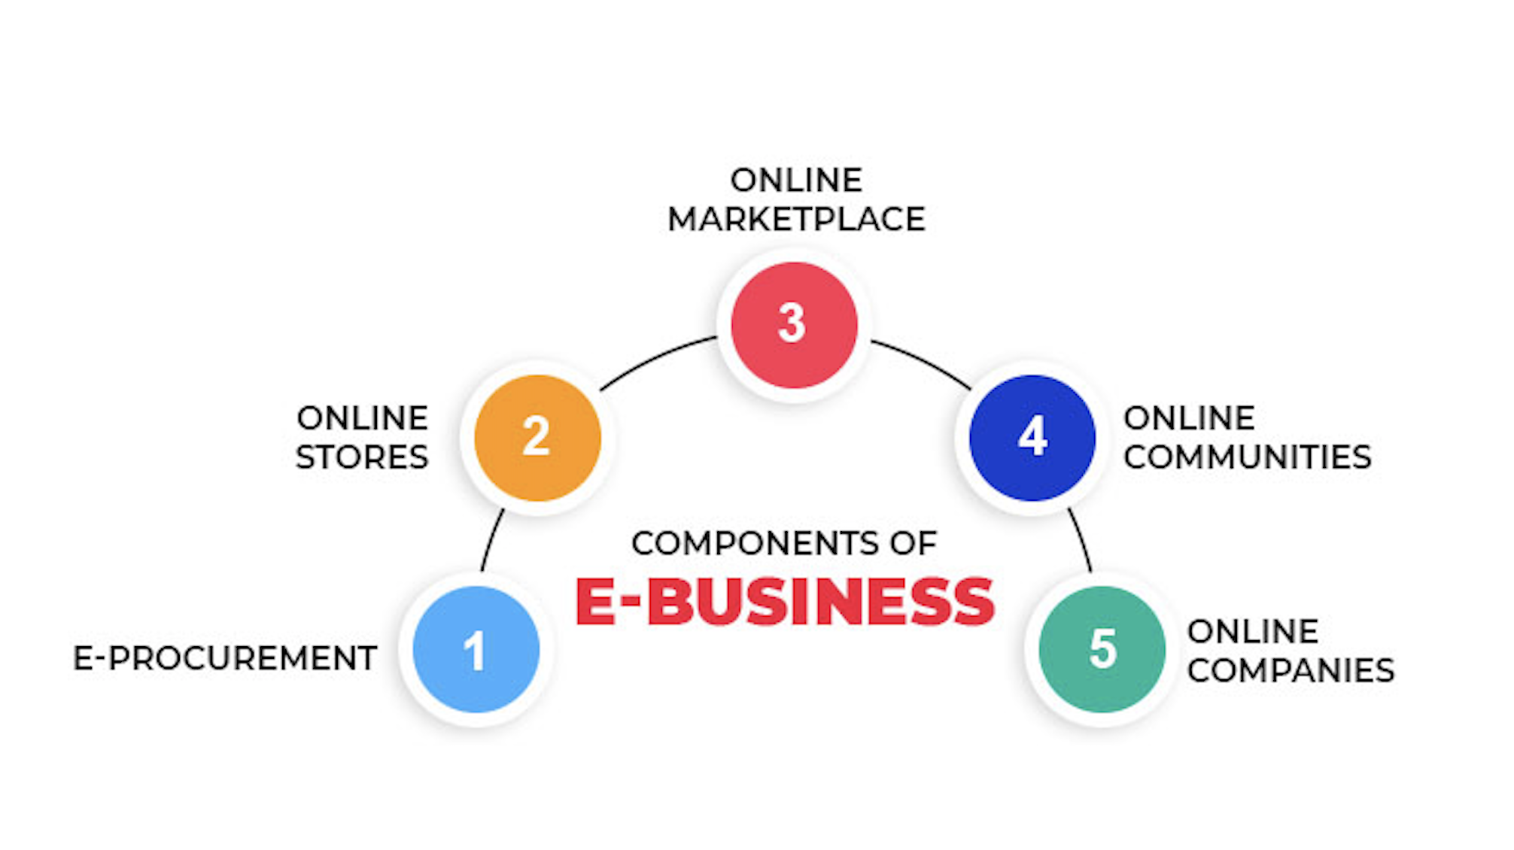

Slide 6
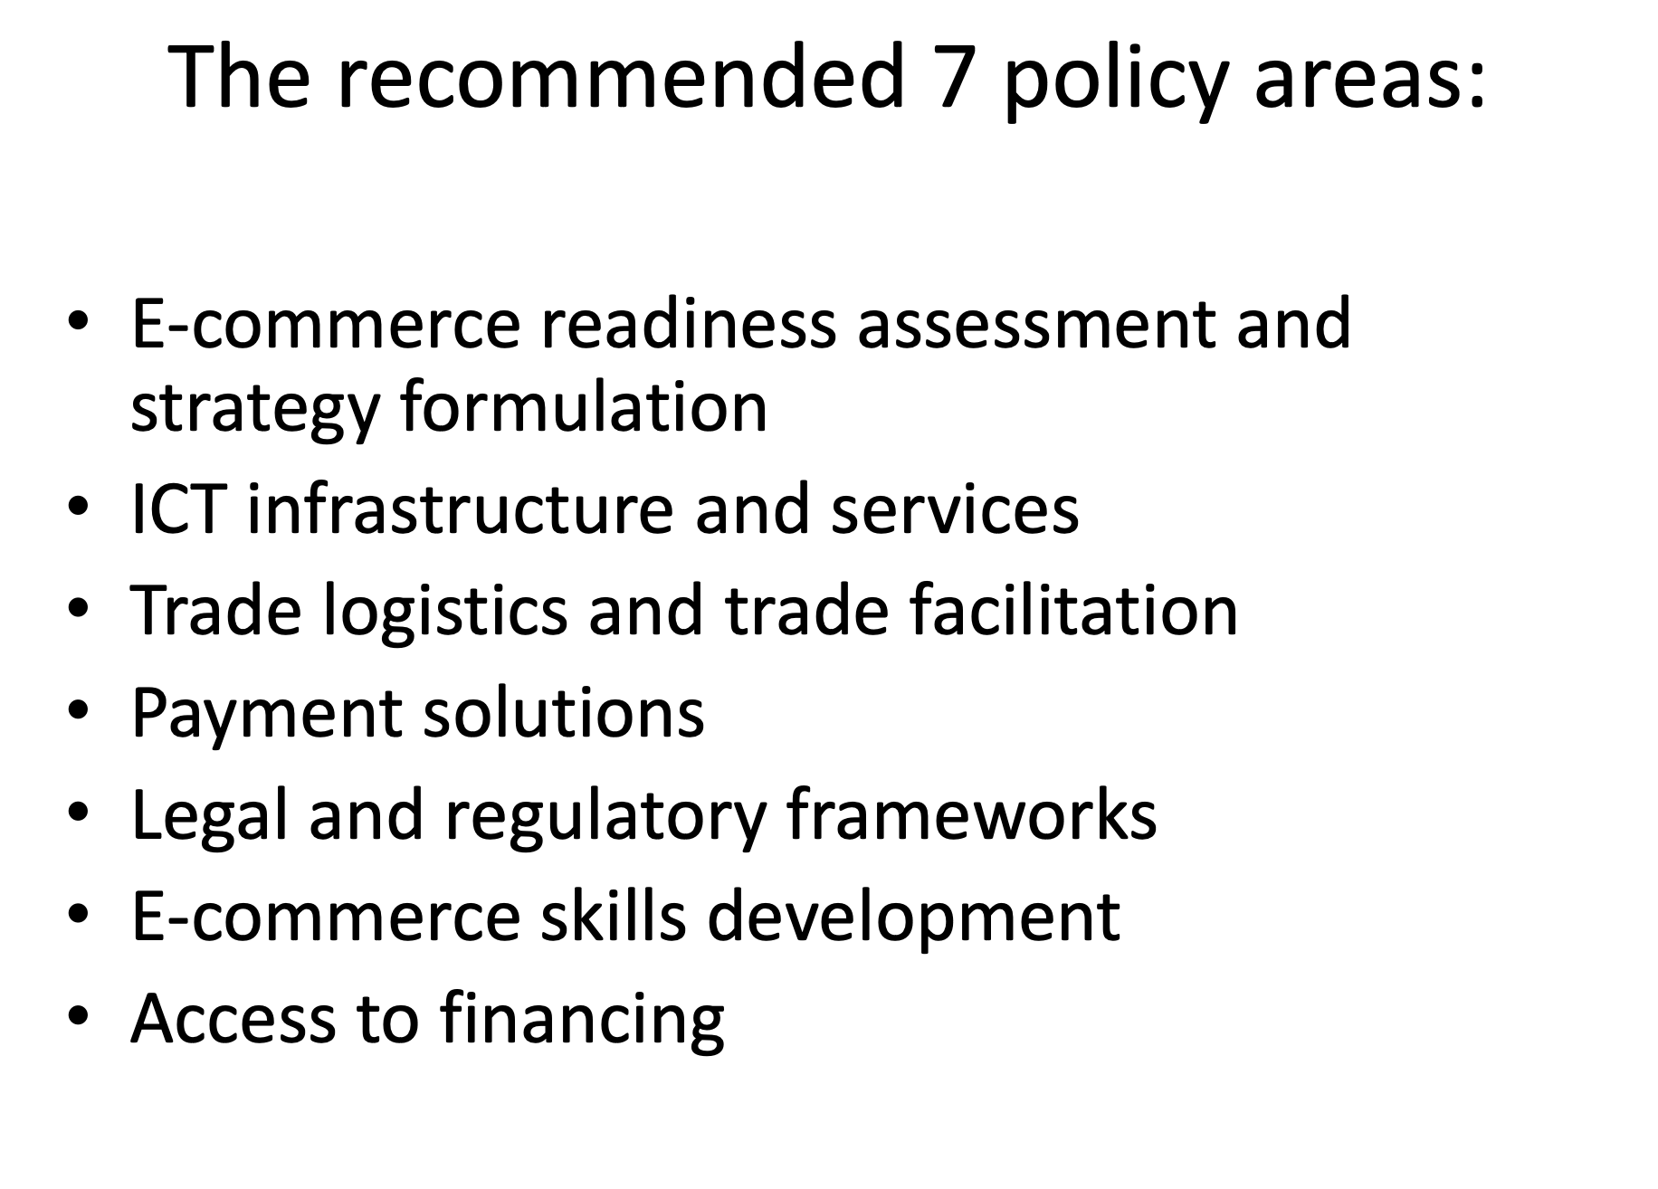

Slide 7
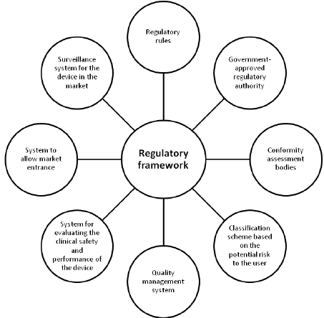
Policy issues and national policy and regulatory framework

Slide 8
Infrastructural issues and challenges
Lack of capital due to poverty.
Lack of skilled human resource and appropriate IT technology
Difficult terrain, and lack of appropriate equipment.
Natural calamities prone country.
Lack of education and awareness.
Political instability.
Dependent mentality.
Some religious and cultural practices hindering local means and resources.

Slide 9
The need for Intellectual and cultural shift

Slide 10
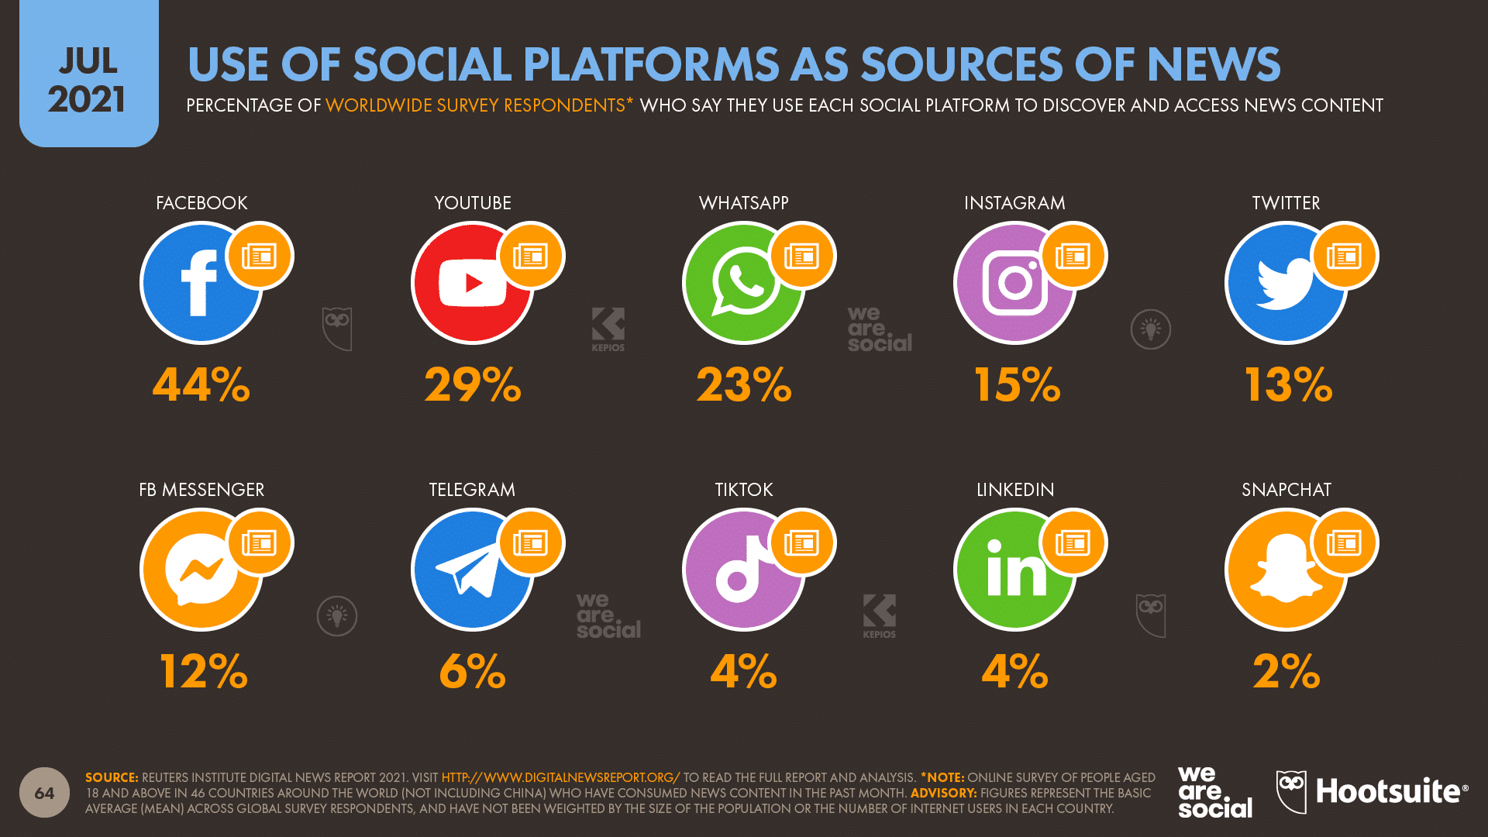
Emerging technological trends and their policy ramifications

Slide 11
Media/Digital convergence
This is also a great example of convergence media. It shows all the devices and how technologies has changed

Slide 12
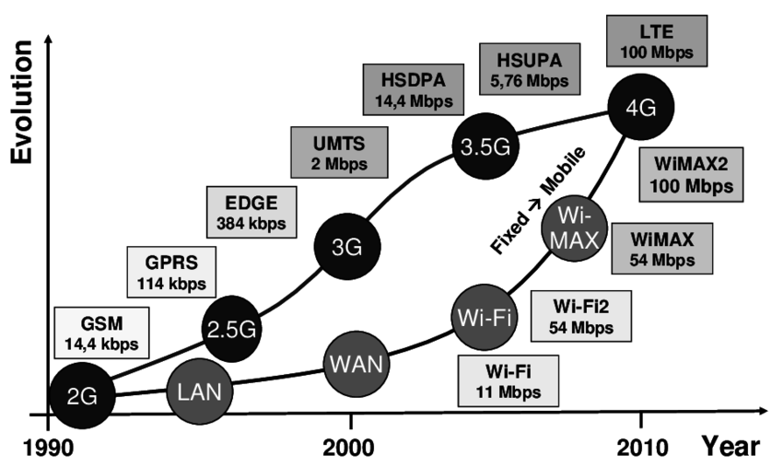
Broadband and IP-enabled services

Slide 13
Basic concept of telecom regulation and Radio-spectrum management
Competition
Pricing
Universal services
Policy
Spectrum management is the combination of administrative and technical procedures necessary to ensure the interference-free and efficient operation of radio services (e.g. Radionavigation).
Frequency management deals with the assignment of frequencies to transmitting and/or receiving stations (e.g. radio station).

